Slide 1


Intelligent Systems and Machine Learning group
TOPIC: A Bayesian Approach to Imitation in Reinforcement Learning
Advances in Reinforcement Learning

Slide 2
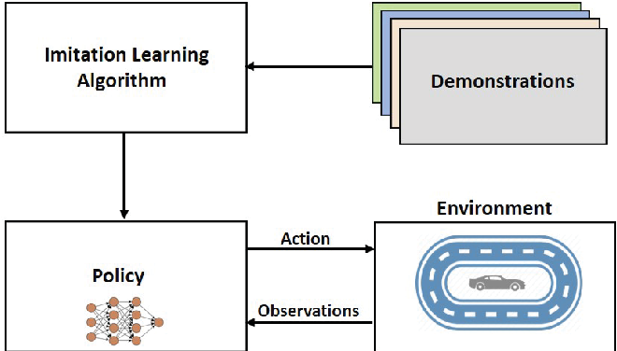
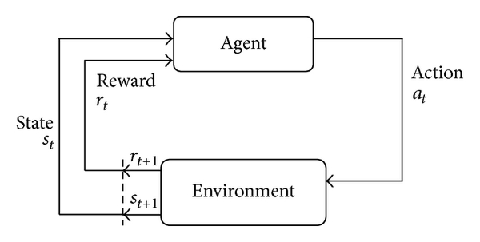


Definition
1. Reinforcement Learning is formulated as
2. Imitation Learning is
This Photo by Unknown Author is licensed under CC BY
Source of this Photo
This Photo by Unknown Author is licensed under CC BY-SA-NC

Slide 3
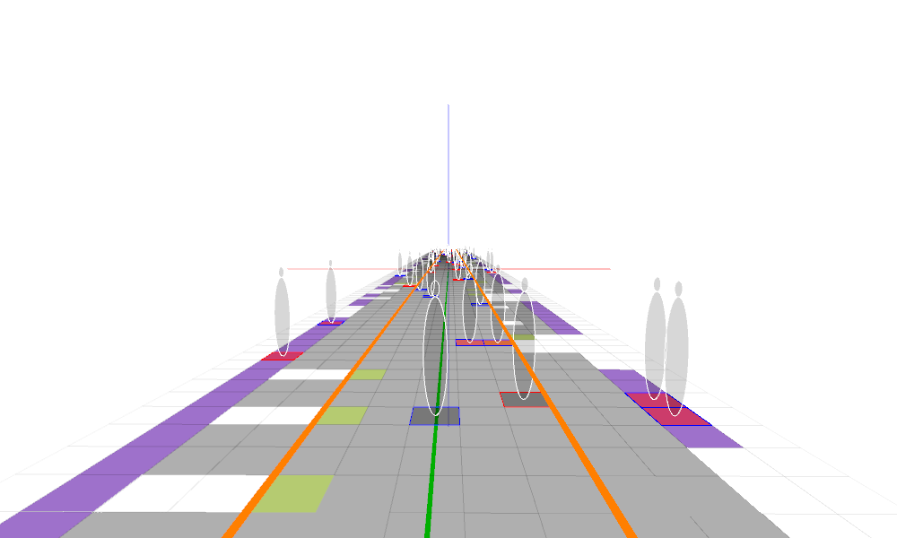
Definition….
3. In this paper,
Re-visit Bayesian Imitation Model
On Multi-agent system environment using,
Prior pool Knowledge
Data from Interaction
Data from (expert) Observations

Slide 4
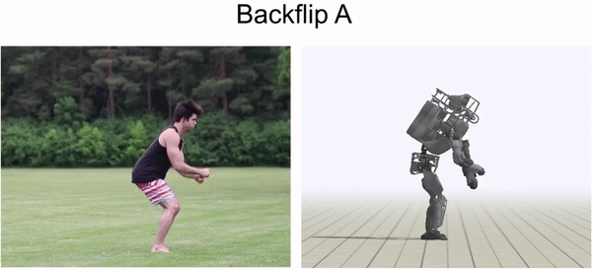
Background
In 1998 Michael Kearns, Satinder Singh , shows that
complexity of reinforcement learning
∝
with number of states
Also, we know that from *,
‘Like me’ assumption in the (learner) Environment
(information about similar action capability w.r.t objective)
Which is ∝ Optimal Learning Strategy
We have seen this in following approaches
Inverse Learning
Imitation in RL
Learning from Demonstrations

Slide 5
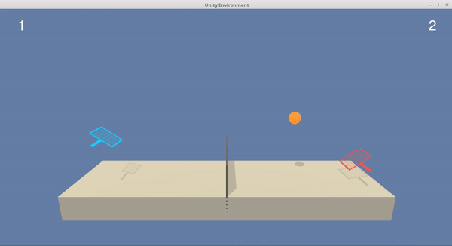
Background…
Challenge,
Multi-agent system usually has (explicit)
Communication channel – language to express – change in actions – Reward Incentive
Unrealistic in real world (design) environment
Observation Based Techniques
Implicit communication through passive observations – Implicit Imitation
Here, Learner can observe agent actions
But Internal state of other agents their actions are not-observable
Independent Exploration of Observer – To learn Agents (implicit/own) needs.
(without duplicates)

Slide 6
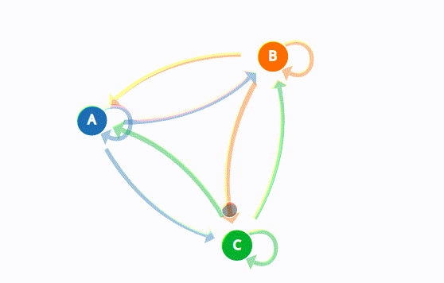
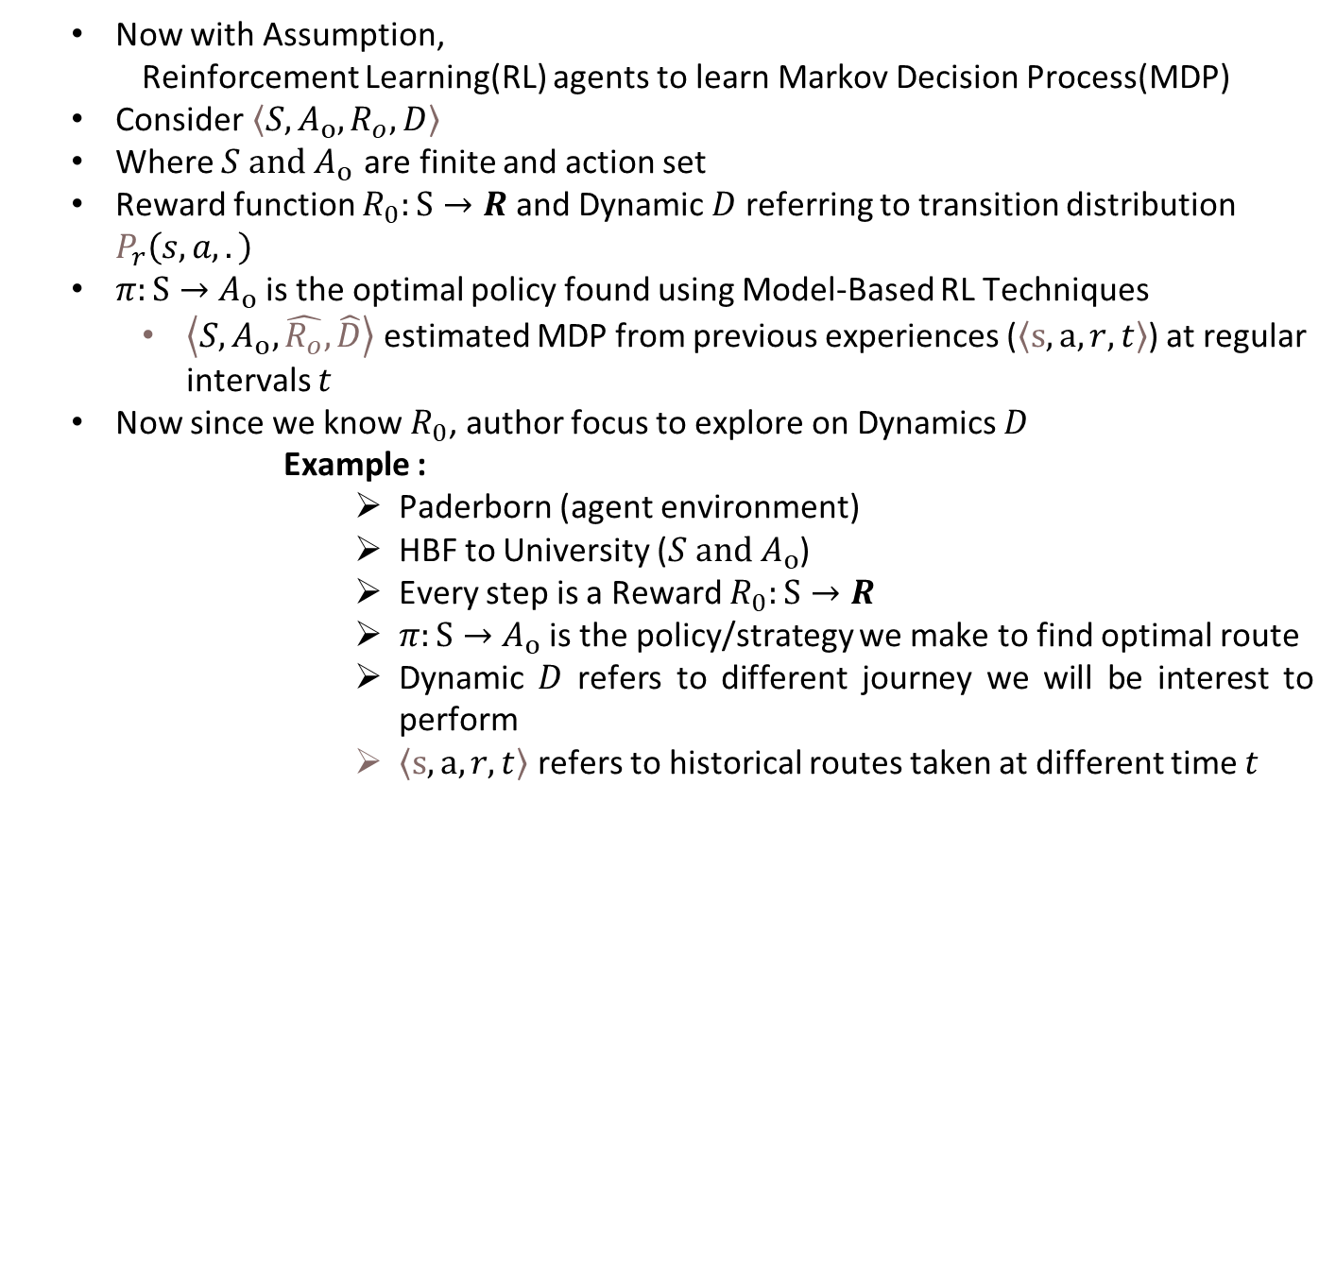
Background…
Now with Assumption,
Reinforcement Learning(RL) agents to learn Markov Decision Process(MDP)
Consider$\left\langle S,A_{o},R_{o},D\right\rangle$
Where $S and A_{o }$are finite and action set
Reward function $R_{0}:S→R$ and Dynamic $D$ referring to transition distribution $P_{r}\left(s,a,.\right)$
$π:S→$ $A_{o}$ is the optimal policy found using Model-Based RL Techniques
$\left\langle S,A_{o},\hat{R_{o}},\hat{D}\right\rangle$ estimated MDP from previous experiences ($\left\langle s,a,r,t\right\rangle$) at regular intervals $t$
Now since we know $R_{0}$, author focus to explore on Dynamics $D$
Example :
Paderborn (agent environment)
HBF to University ($S and A_{o}$)
Every step is a Reward $R_{0}:S→R$
$π:S→$ $A_{o}$ is the policy/strategy we make to find optimal route
Dynamic $D$ refers to different journey we will be interest to perform
$\left\langle s,a,r,t\right\rangle$ refers to historical routes taken at different time $t$

Slide 7
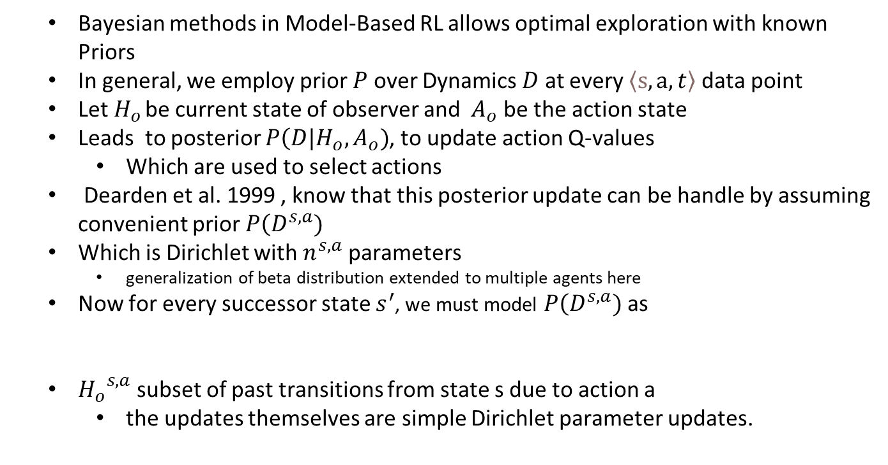
Background…
Bayesian methods in Model-Based RL allows optimal exploration with known Priors
In general, we employ prior $P$ over Dynamics $D$ at every $\left\langle s,a,t\right\rangle$ data point
Let $H_{o }$be current state of observer and $A_{o}$ be the action state
Leads to posterior $P\left(\left.D\right.|\right.H_{o},A_{o})$, to update action Q-values
Which are used to select actions
Dearden et al. 1999 , know that this posterior update can be handle by assuming convenient prior $P\left(D^{s,a})\right.$
Which is Dirichlet with $n^{s,a}$ parameters
generalization of beta distribution extended to multiple agents here
Now for every successor state $s^{′}$, we must model $P\left(D^{s,a})\right.$ as
${H_{o}}^{s,a}$subset of past transitions from state s due to action a
the updates themselves are simple Dirichlet parameter updates.

Slide 8
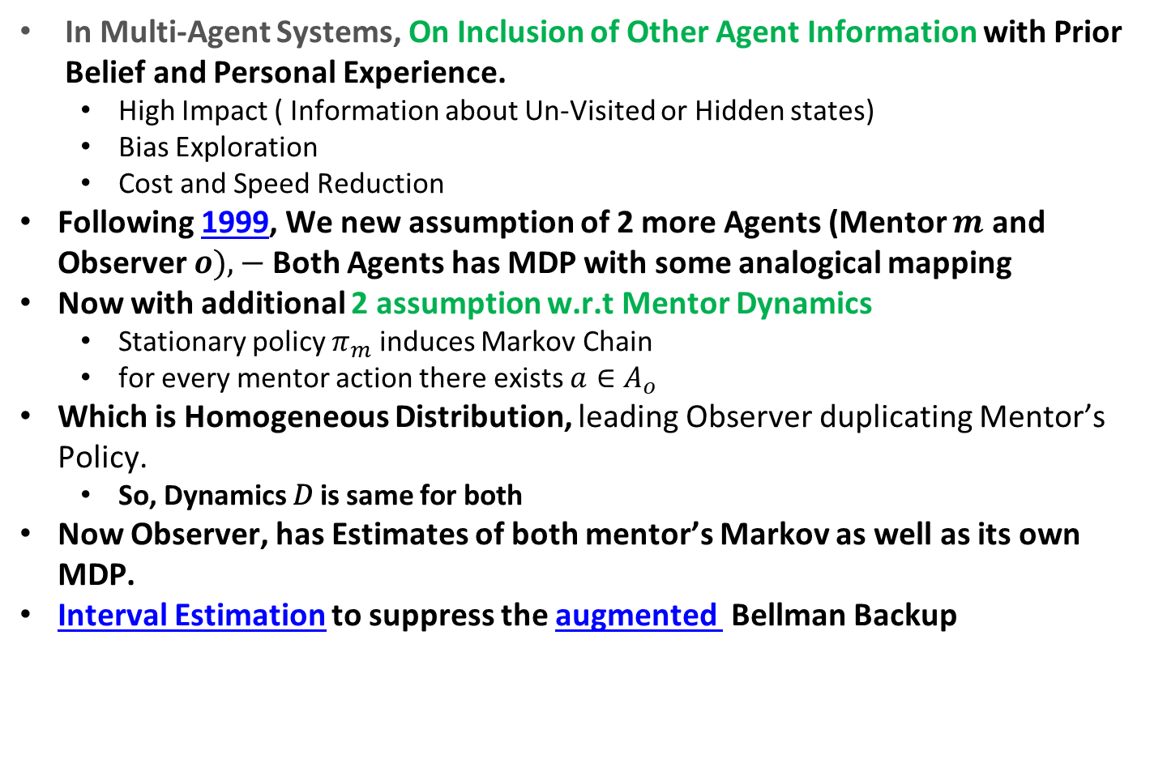
Bayesian Imitation
In Multi-Agent Systems, On Inclusion of Other Agent Information with Prior Belief and Personal Experience.
High Impact ( Information about Un-Visited or Hidden states)
Bias Exploration
Cost and Speed Reduction
Following 1999, We new assumption of 2 more Agents (Mentor $m$ and Observer $o),−$Both Agents has MDP with some analogical mapping
Now with additional 2 assumption w.r.t Mentor Dynamics
Stationary policy $π_{m}$ induces Markov Chain
for every mentor action there exists $a∈A_{o}$
Which is Homogeneous Distribution, leading Observer duplicating Mentor’s Policy.
So, Dynamics 𝐷 is same for both
Now Observer, has Estimates of both mentor’s Markov as well as its own MDP.
Interval Estimation to suppress the augmented Bellman Backup

Slide 9
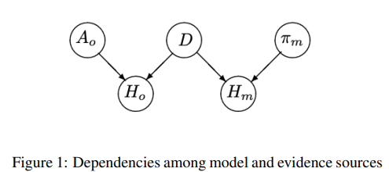
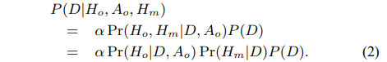
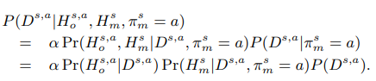
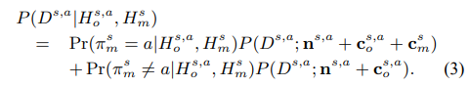
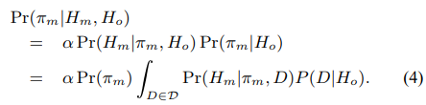
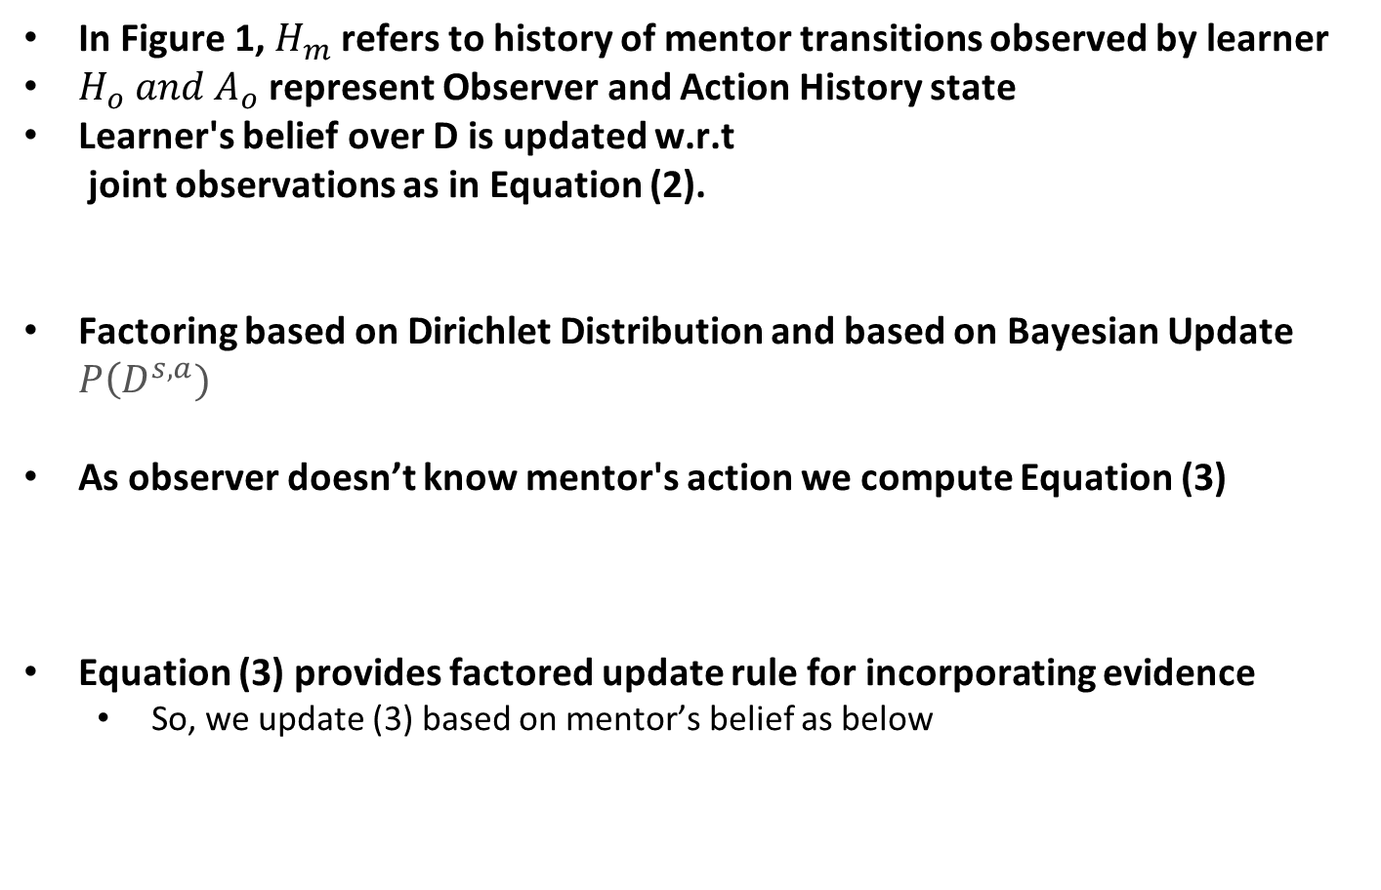
Bayesian Imitation…
In Figure 1, $H_{m}$ refers to history of mentor transitions observed by learner
$H_{o} and{ A}_{o}$ represent Observer and Action History state
Learner's belief over D is updated w.r.t
joint observations as in Equation (2).
Factoring based on Dirichlet Distribution and based on Bayesian Update $P\left(D^{s,a})\right.$
As observer doesn’t know mentor's action we compute Equation (3)
Equation (3) provides factored update rule for incorporating evidence
So, we update (3) based on mentor’s belief as below

Slide 10
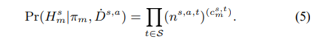
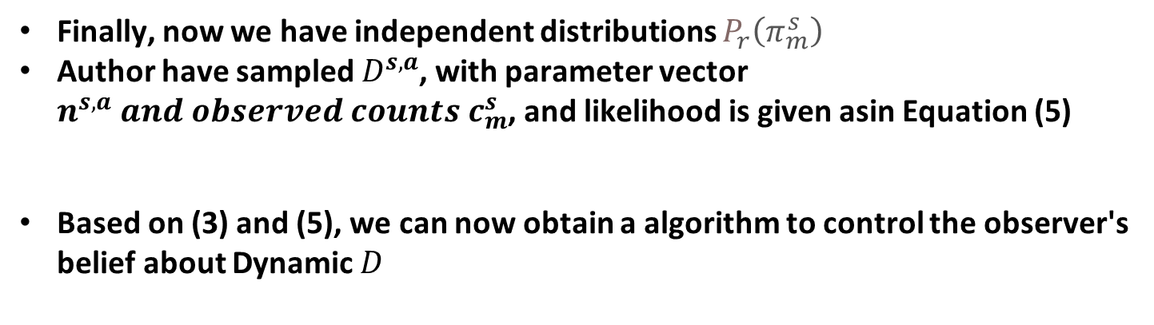
Bayesian Imitation…
Finally, now we have independent distributions $P_{r}\left(π_{m}^{s}\right)$
Author have sampled $D^{s,a}$, with parameter vector $n^{s,a} and observed counts c_{m}^{s}$, and likelihood is given asin Equation (5)
Based on (3) and (5), we can now obtain a algorithm to control the observer's belief about Dynamic $D$

Slide 11
Experiment and Domains Tested
Oracle-Agents in Experiment settings:
EGBS : Epsilon-Greedy exploration with complete Bellman backup.
EGPS: Epsilon-Greedy exploration with Prioritized Sweeping
BEBI: Bayesian Exploration with Bayesian Imitation
EGBI: Epsilon Greedy with Bayesian Imitation
EGNBI: Epsilon Greedy with No Bayesian Imitation
Domains used:
Loop and Chain Examples
Flagworld
Tutoring domain (less training time)

Slide 12
Conclusion
We saw How Implicit Imitation in Bayesian Framework.
Advantages of Model-Based RL
Leveraging information about Environment can help in learning
On adoption of Dynamics, we can be confident on decision process
Bayesian Imitation in General:
At every intervals, imitator observes its own state transition along with mentor state
Using each state to update its distribution (density)
Agent value is updated
Selects suitable action and execute it
Repeat the cycle

Slide 13
Thank you ☺
HARSHITH SRINIVAS | 6896703

